Slide 1
CEATTLE WGSAM Model
Single-species

Slide 2
Specifications
Single-species
Capelin, Haddock, Cod
Spring and fall survey, 1 fishing fleet each
Non-parametric time-invariant selectivity (fleet/season specific)
Analytical catchability (fleet/season specific)
GitHub Repo

Slide 3
Data inputs
Survey biomass (simSurveyIndex) : lognormal
Catch (simCatchIndex): lognormal
Fishery and survey age-comp (simXXXAgecomp) : multinomial
Sample size? Used 200
No length comp because avoiding “agecl” to “age” conversion
Input weight-at-age (simXXXWtatAge)
Maturity knife-edge at 0.5 max age
Sex ratio = 0.5 for all ages
M = 0.2 (estimating M hits bounds for capelin)

Slide 4
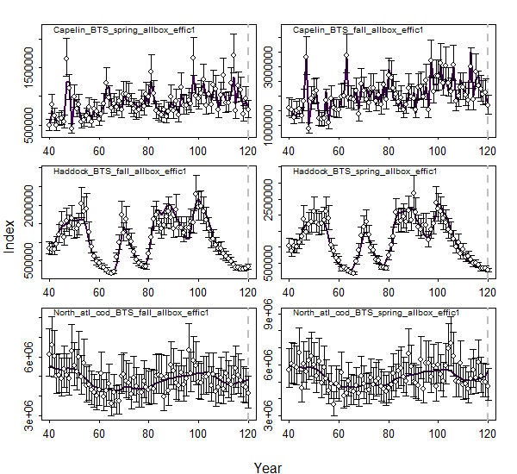
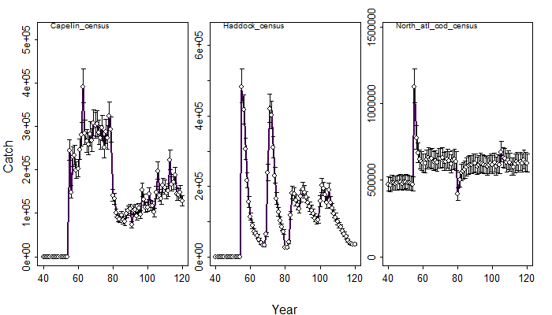
Survey fit
Catch fit

Slide 5
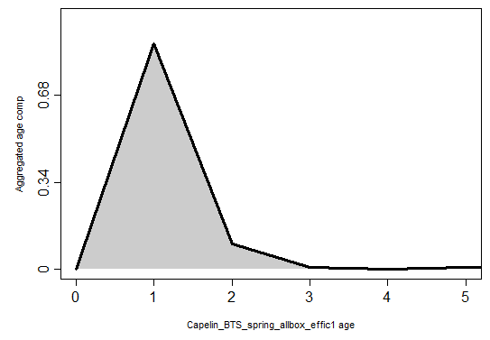
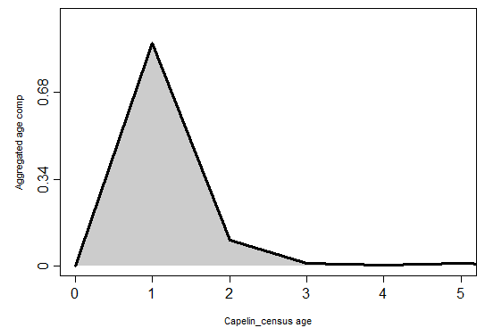

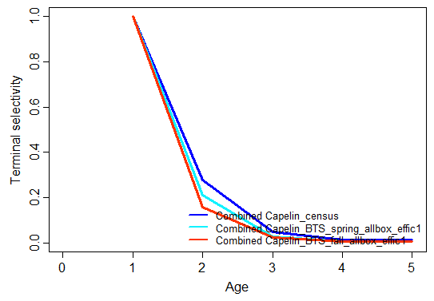
Selectivity and comp - Capelin

Slide 6
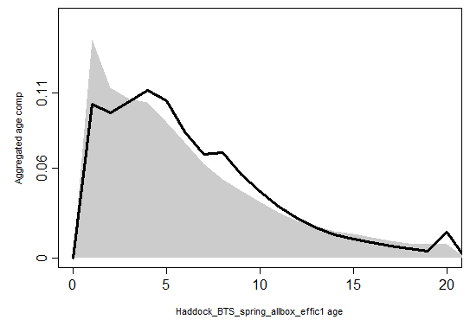
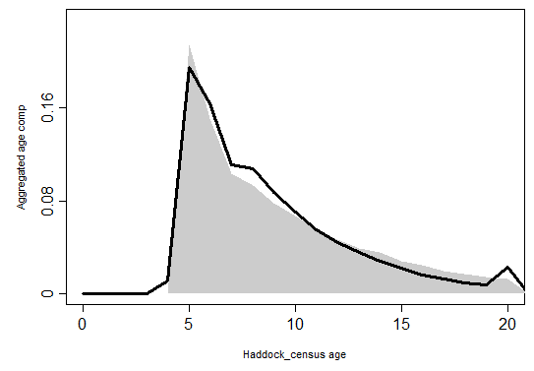
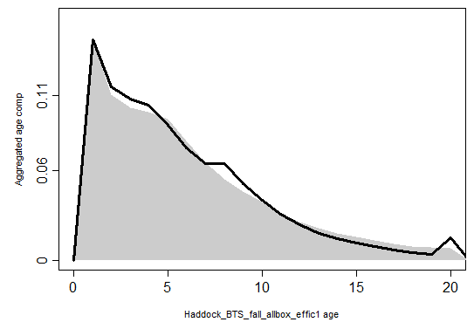
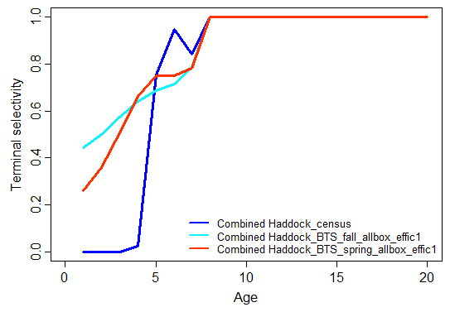
Selectivity and comp - Haddock

Slide 7
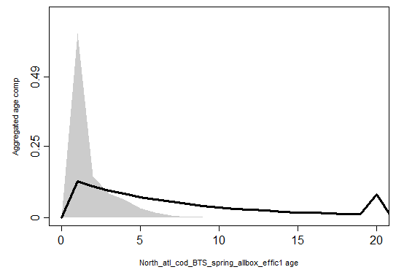
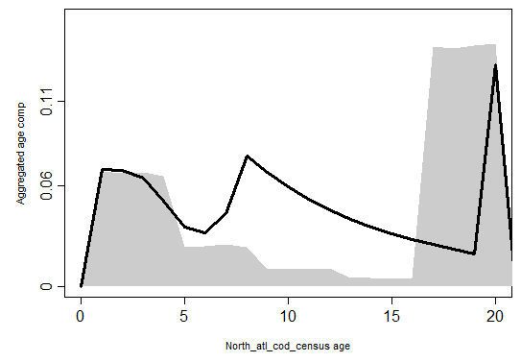
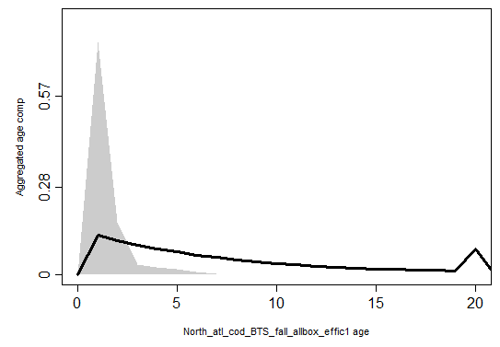
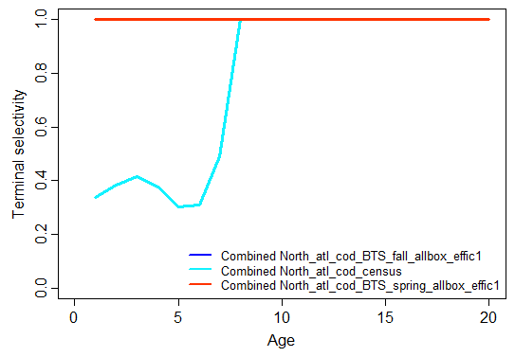
Selectivity and comp - Cod

Slide 8
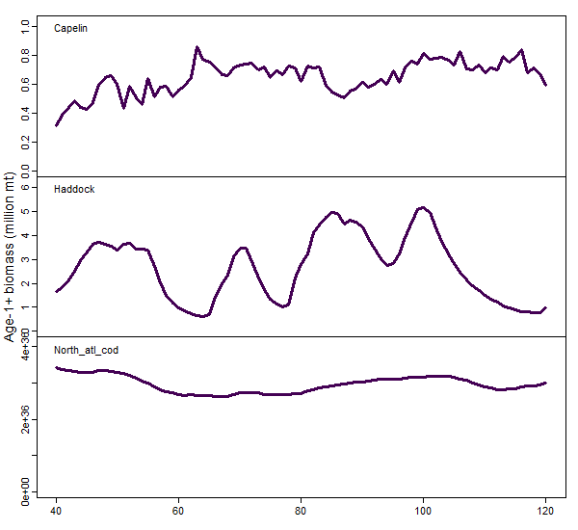
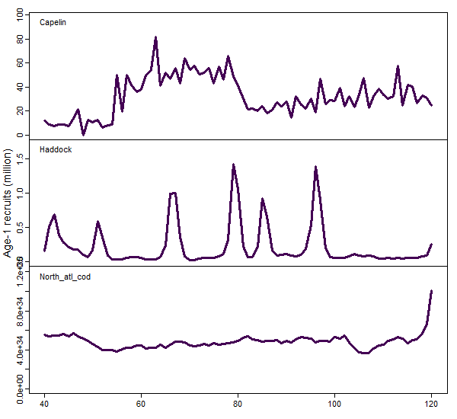
Biomass and recruitment
Biomass
Recruitment

Slide 9
Overview
CEATTLE seems to be fitting capelin and haddock quite well
Cod is not fitting well (comp data are wonky and lack of trends in catch and index make it hard)
Biomass and recruitment estimates seem reasonable?
Scripts developed to easily add in more species
Any others worth estimating?

Slide 10
Next steps and recommendations
Add in diet and bioenergetics data
Still need to work through data to understand how to approach it
Add in additional species
Update cod data or remove from model
Think through outline of intro/methods:
I think we need a written framework to ensure simulation testing is well controlled
Cant see true biomass estimates (otherwise well try and mimic them)
What's our performance criteria (dictates what outputs I produce)

